Slide 1



Recommendation System DATAQUEST
Presented by: Moegamat Rashaad Samsodien

Slide 2
OVERVIEW
2 Solution Approach
3
Evaluation Metrics
1 Problem Statement
5
Business Impact & Next Steps
4
Interpretation & Caveats

Slide 3
Problem Statement
How can we leverage minimal customer interaction data to deliver relevant, actionable product
recommendations that are not only accurate but also unique, diverse, and highly personalized
especially for customers with limited historical data within FNB’s Retail & Commercial banking ecosystem?
This challenge pushes us beyond traditional recommender systems that focus solely on accuracy.
Our goal is to maximize business impact by enhancing customer satisfaction, deepening engagement,
and unlocking new cross-sell opportunities through a model that prioritizes and ranks offers using contextual
insights and inferred customer needs.

Slide 4
Solution Approach

Slide 6
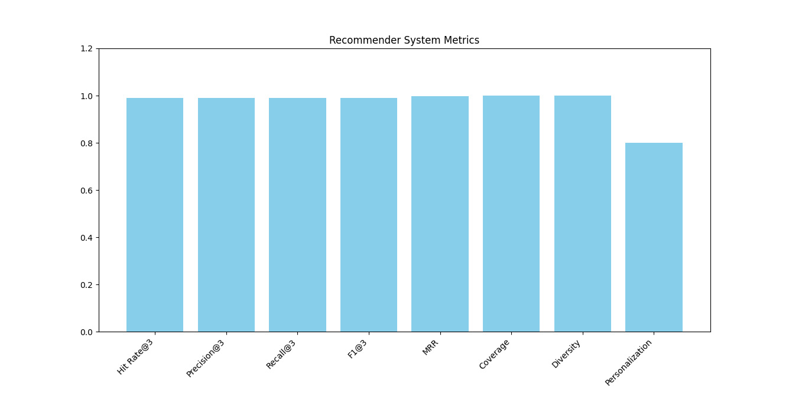

Slide 7
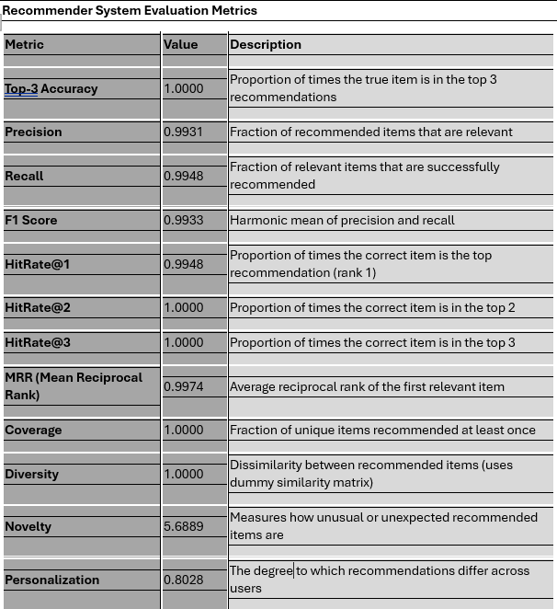
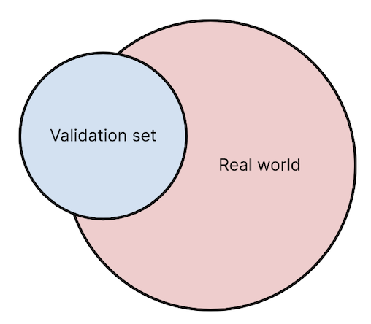
Promising Results – But Real-World Validation Is Key
Recommender System Evaluation Metrics

Slide 8

Business Impact & Next Steps
Deploy a pilot with a small user group.
Monitor performance in real time—track uptake, clicks, and engagement.
Explore deeper user profiling or add a feedback loop to improve recommendations over time.

